Slide 1
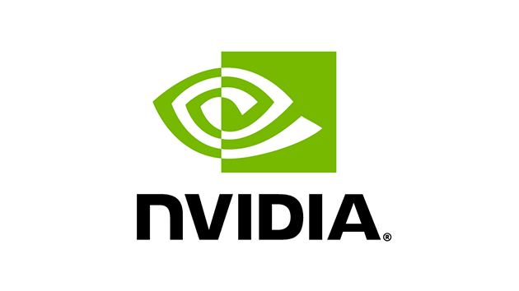
Recommendation:
BUY
Target Price:
USD $298.50 (+11.6%)
Current Price:
USD $267.59
Group 1:
1005461 James Huang
1005488 Huang XinYi
1005018 Low Haoron
1004639 Chan Kah Yan
Notes:
Nvidia is a leading technology company with a
Because of its Strong leadership position in the GPU market
And the high potential growth in the data center and AI markets.
We recommend a BUY rating for Nvidia.
Furthermore, based on 40 analyst that gave a median price target of USD $298, representing a potential upside of 11%.

Slide 2
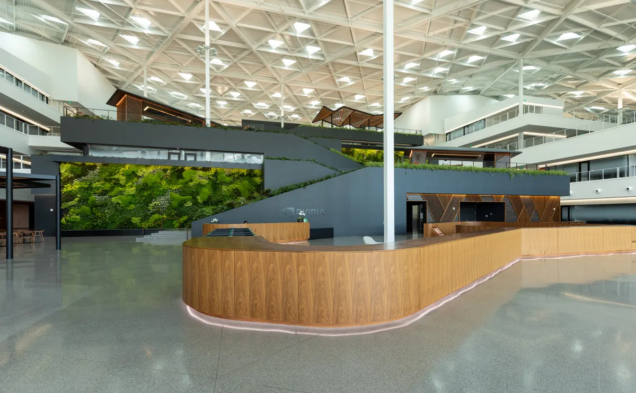
Content Page
01
02
03
04
Nvidia’s Overview
Nvidia’s Finances
Strengths
Assumptions
Notes:
For our stock pitch on Nvidia, This will be our content page

Slide 3
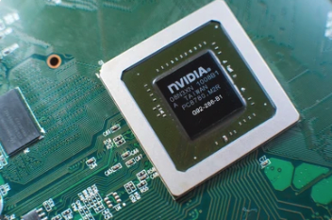
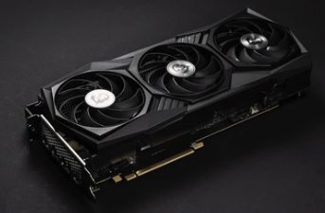
01
Nvidia’s
Overview

Slide 4
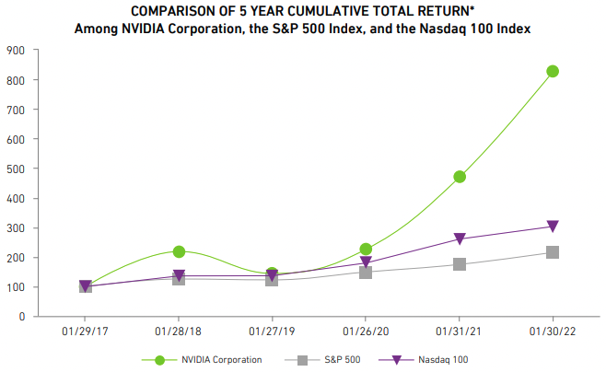
Nvidia Overview
Nvidia’s Business model:
Graphics Segment
Compute & Networking segment
*$100 invested on 1/29/17 in stocks and indices, including reinvestment of dividends
 | 1/29/2017 | 1/28/2018 | 1/27/2019 | 1/26/2020 | 1/31/2021 | 1/30/2022
NVIDIA Corporation | $100.00 | $218.55 | $144.24 | $226.48 | $470.59 | $828.15
S&P 500 | $100.00 | $125.54 | $122.64 | $149.23 | $174.97 | $215.72
Nasdaq 100 | $100.00 | $136.00 | $136.62 | $179.79 | $260.70 | $303.21
Notes:
https://s201.q4cdn.com/141608511/files/doc_financials/2022/ar/2022-Annual-Review.pdf
Firstly, let me introduce Nvidia.
Nvidia is a technology company that operates in two segments:
Graphics segment (which mainly includes the graphical processing units)
Compute & Networking (includes Data center platforms and systems for AI)
Furthermore, in the past 5 years,
Nvidia has greatly outperformed S&P500 and Nasdaq100

Slide 5
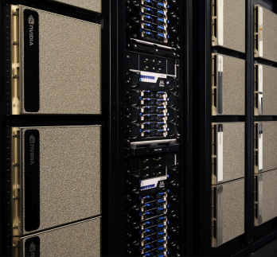
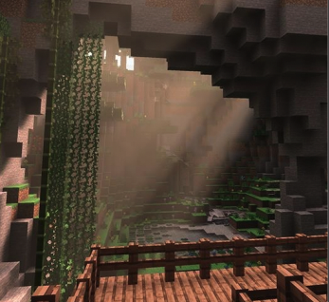

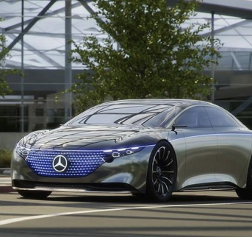
Nvidia’s Market
Professional Visualization
6% of FY23 revenue
Data Center
56% of FY23 revenue
Gaming
33% of FY23 revenue
Automotive
3% of FY23 revenue
Notes:
Nvidia’s strong market returns is mainly due to its strong position in the Data center, gaming, Professional visualization and Automotive market.
With Data center and gaming being the majority of Nvidia’s revenue.

Slide 6
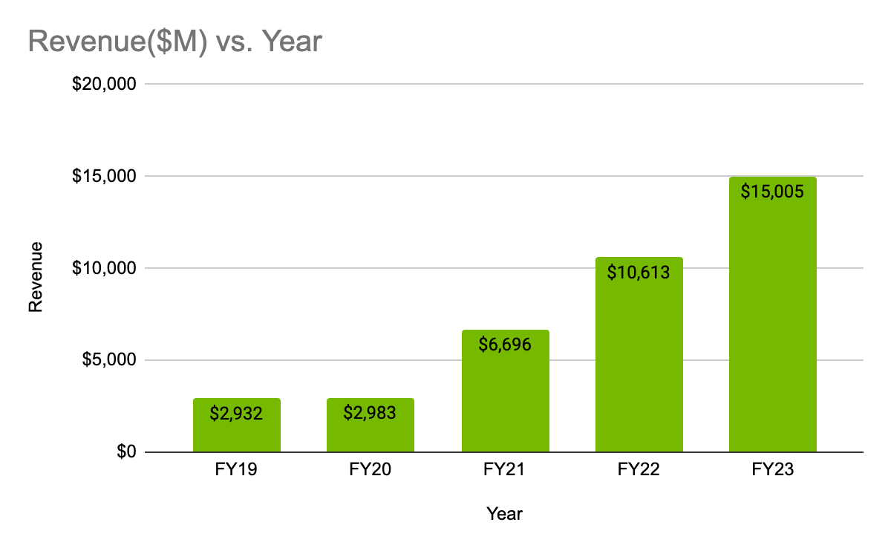
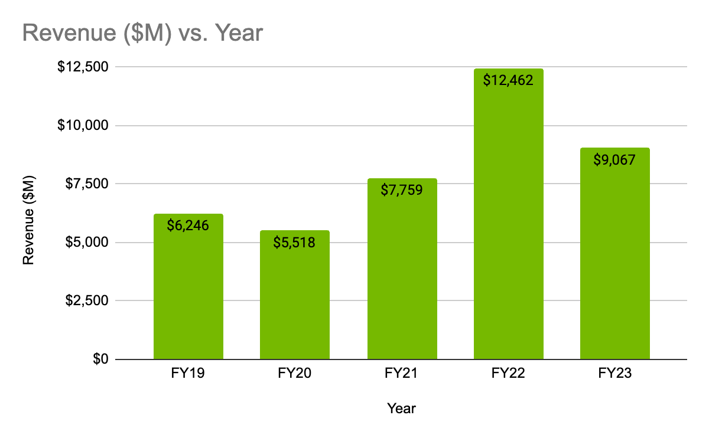
Leader in Data Center & Gaming
Data Center
Gaming
-27.2%
38.6%
5-Year CAGR
Leader in AI
Used by all hyperscale & major cloud computing providers
Leader in PC Gaming
Strong #1 market position with over 80% market share
Notes:
Lets take a closer look at Nvidia's dominance in the data center and gaming market.
Over the past five years, Nvidia has achieved an impressive Compound Annual Growth Rate (CAGR) of 38.6%
its leadership in artificial intelligence (AI)
Its technology is used by all hyperscale and major cloud computing providers, including Amazon, Google.
Gaming on the other hand. Faces a slow down in revenue in 2022.
Fortunately, Nvidia still maintain its strong market position of 80% market share
https://s201.q4cdn.com/141608511/files/doc_presentations/2023/02/nvda-f4q23-investor-presentation-final.pdf

Slide 7
Nvidia’s Revenue Sharing Model
Graphics card & Data centers
Cloud Service Providers
Computing Power
Subscription Model
Licensing Fees
Use of Technology
Notes:
Next,
Nvidia earns its revenue basically from …. Earning revenue through the sale of its products and services to partners and customers, as well as through licensing fees for the use of its technology.

Slide 8
02
Nvidia’s
Finances

Slide 9
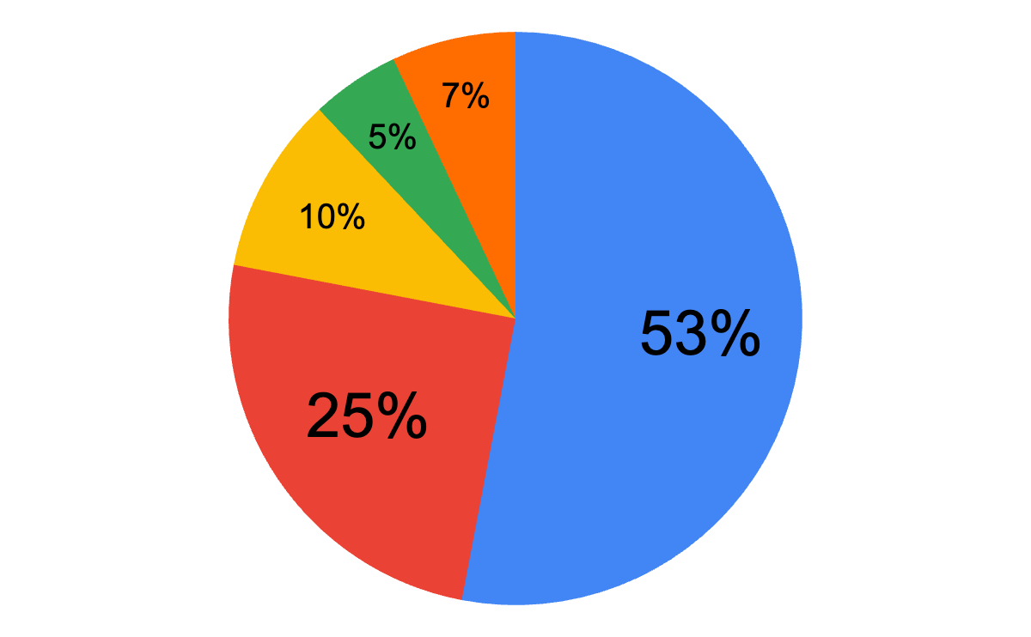
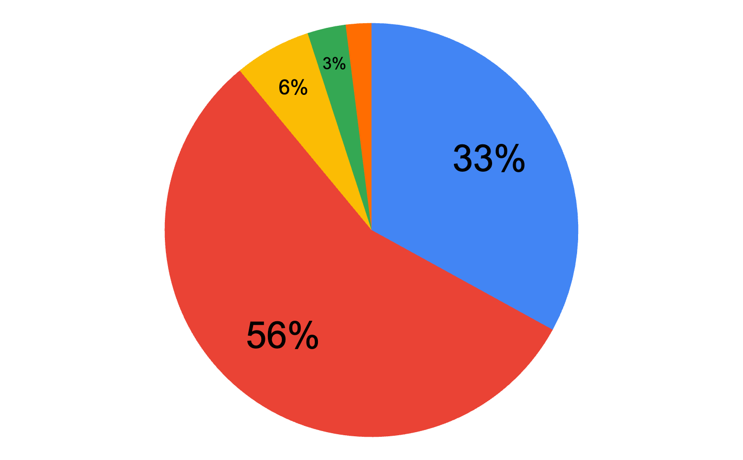
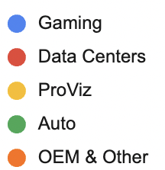
Nvidia Finances
FY 23
FY 19
FY23: Data Centers becoming a major part of Nvidia’s revenue component
Notes:
https://s201.q4cdn.com/141608511/files/doc_presentations/2023/02/nvda-f4q23-investor-presentation-final.pdf
https://s201.q4cdn.com/141608511/files/doc_financials/2022/ar/2022-Annual-Review.pdf
Under Nvidia’s financials, we can see from this pie chart that the Data centers have become a biggest component of Nvidia’s revenue.

Slide 10
03
NVIDIA’s
Strength

Slide 11
Nvidia’s Strength
Powerhouse In the Industry
High Future Revenue Growth

Slide 12


Powerhouse In the Industry
Greater customizability for domain-specific applications
Greatest cost-efficiency gains for AI workloads
Notes:
Nvidia is a powerhouse in the industry. It provides greater customizability for domain-specific applications that enable greater flexibility to meet specific AI needs and it offers the greatest cost-efficiency for AI workloads that help firms reduce cost.

Slide 13

Customizable GPUs for domain-specific applications
Nvidia’s CUDA
Compatible with common programming languages
Provides more customizability for AI models.
Over 300 libraries libraries
400 AI models
Notes:
Through the use of CUDA, a parallel computing platform and computing model. Developers can easily write software programs using familiar programming languages and subsequently execute them on Nvidia GPUs.
Moreover, Nvidia has a suit of more than 300 libraries and 400 AI models that enables developers to create their own model that best suits their AI needs.

Slide 14
Strong Developer Network
CUDA Downloads
No. of Developers
3.5M
37M
3.5X
4.5X
1M
8.2M
2019
2023
2019
2023
Notes:
As such, there is an increase of over 4 times in their CUDA downloads and an increase of over 3 times in the number of developers. Which widen’s Nvidia’s developer ecosystem.

Slide 15
Nvidia software ecosystem ahead of AMD
“We like the looks of the MI300 [AMD hardware] and the roadmap, but the software ecosystem [AMD] is still a problem,”
Tease (Lenovo’s vice president of HPC and AI, tell)
“[Developing software] takes much longer than most people would realize. And I think they [AMD] had several experiences, which were understaffed, underfinanced. …So they are not there yet, but they're getting much closer to having the stack, which makes sense.”
Former Head of AI Developer Relations at Nvidia
Notes:
In contrast to AMD who is Nvidia’s largest competitor in the data centre market which has a software ecosystem problem due to AMD’s software-side being understaffed and underfinanced.

Slide 16
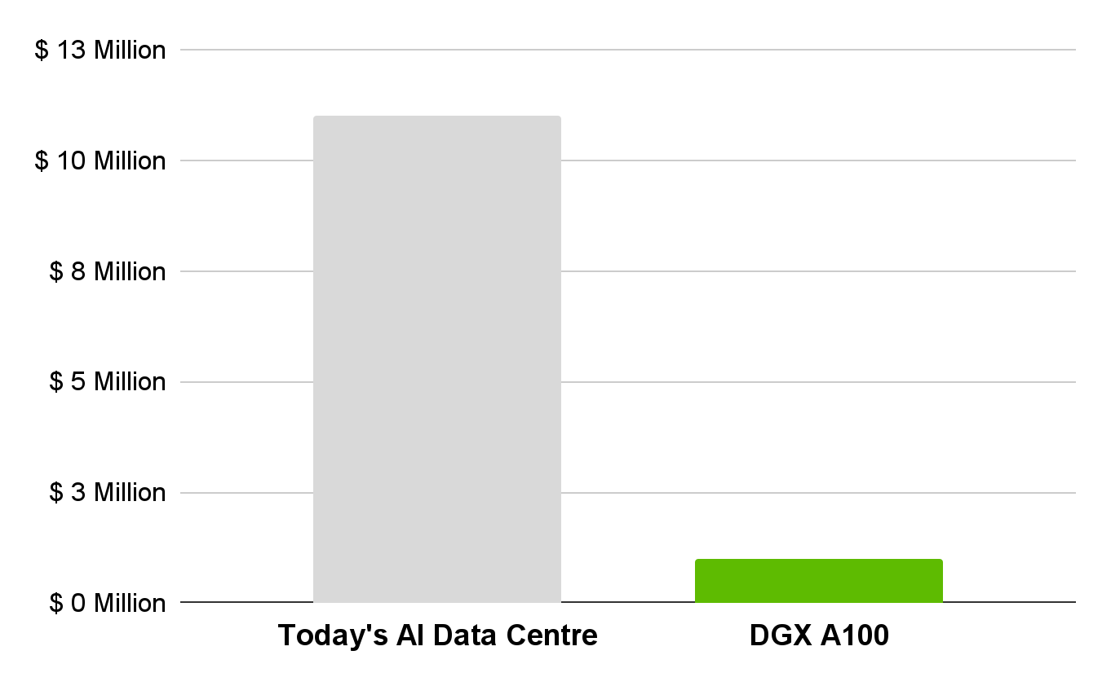
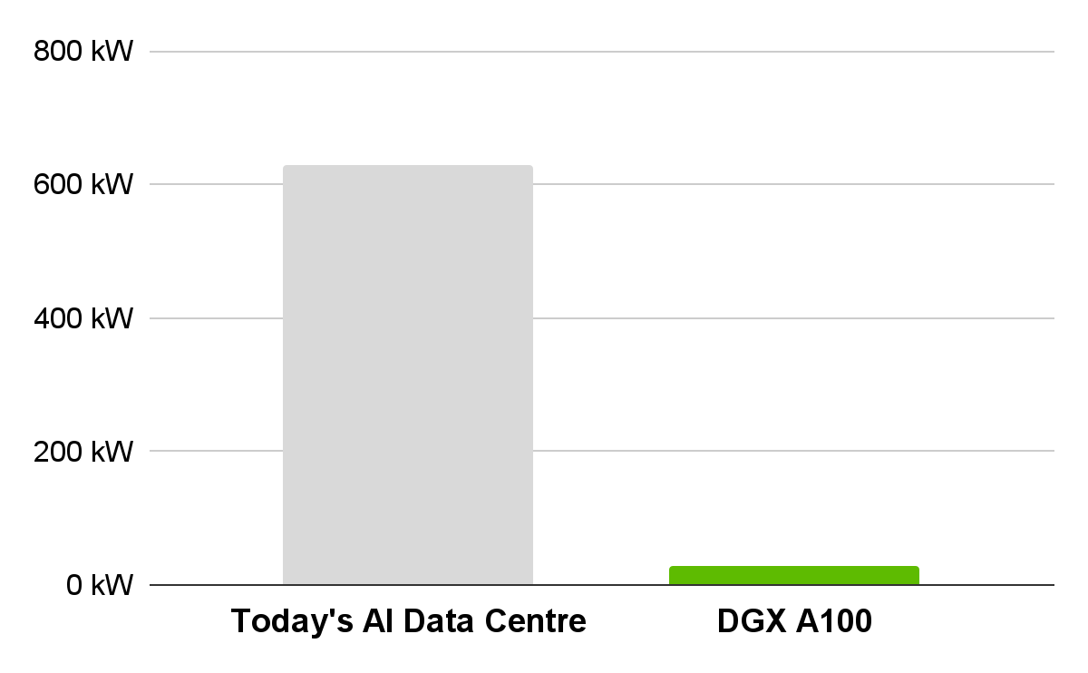
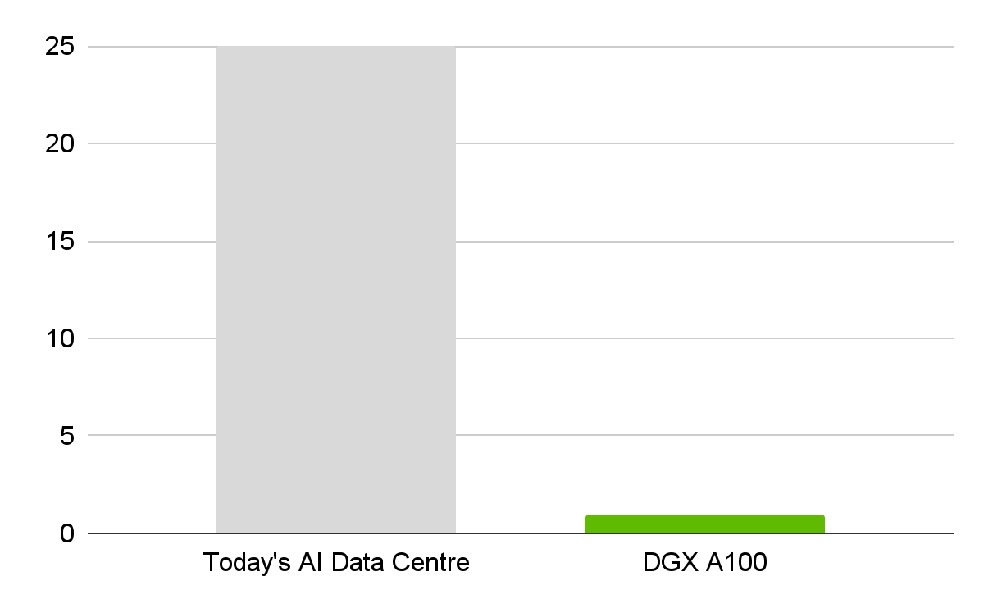
Greatest cost-efficiency for AI workloads
Lower cost
Power (Energy Uptake)
Number of racks
1/20 power consumption
1/10 cost
1/25 racks
Notes:
Moreover, in comparison with a normal AI data centre Nvidia’s A100 GPU data centre has one tenth of the cost, consumes one twentieth of the power and one A100 GPU rack produces as much AI workloads as 25 racks from a normal AI data centre. This allows Nvidia’s data centre clients to cut-cost while producing the same level of AI workloads.

Slide 17
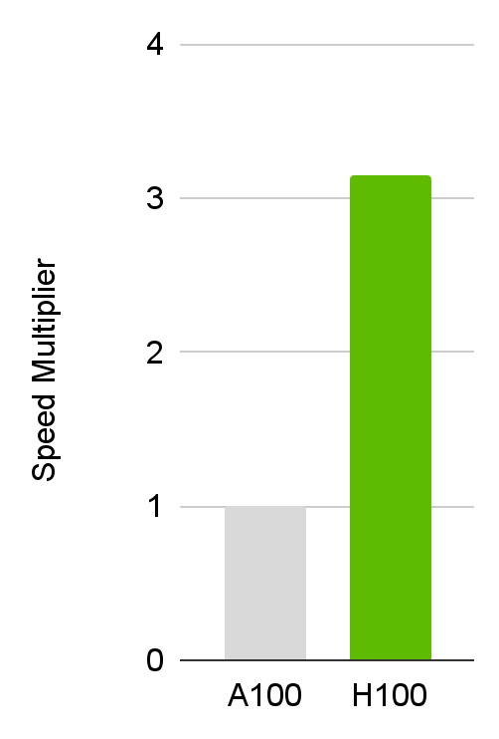
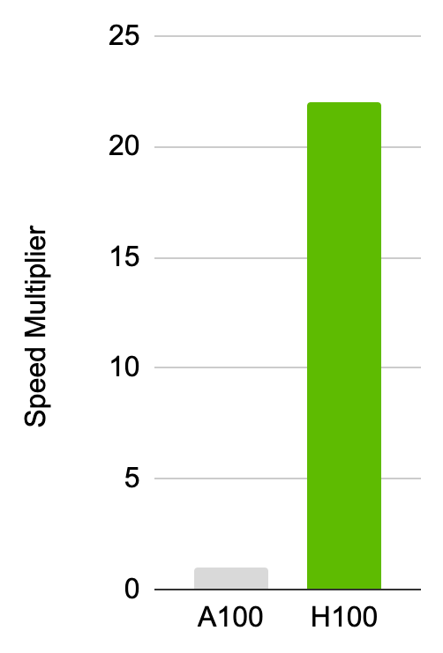
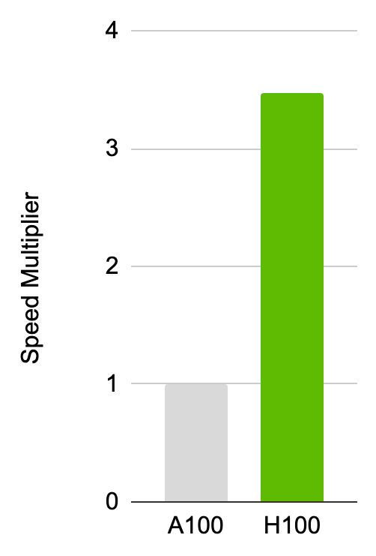
Nvidia to remain leader in data centre
Major faster speeds in data center GPU for AI workloads
Revenue from new H100 GPU is already higher than prior models
HPC
AI Inferencing
AI Training
3X
20X
3X
Notes:
In addition, we further expect Nvidia to remain the leader in the data centre market with their newer H100 GPU. It offers faster AI speeds of over 3 times for High Performance Computing, over 15 times for AI Inferencing, and over 3 times for AI training compared to the A100. As such, we expect that the data centre clients would be able to get even greater AI workload performance for the same cost.

Slide 18
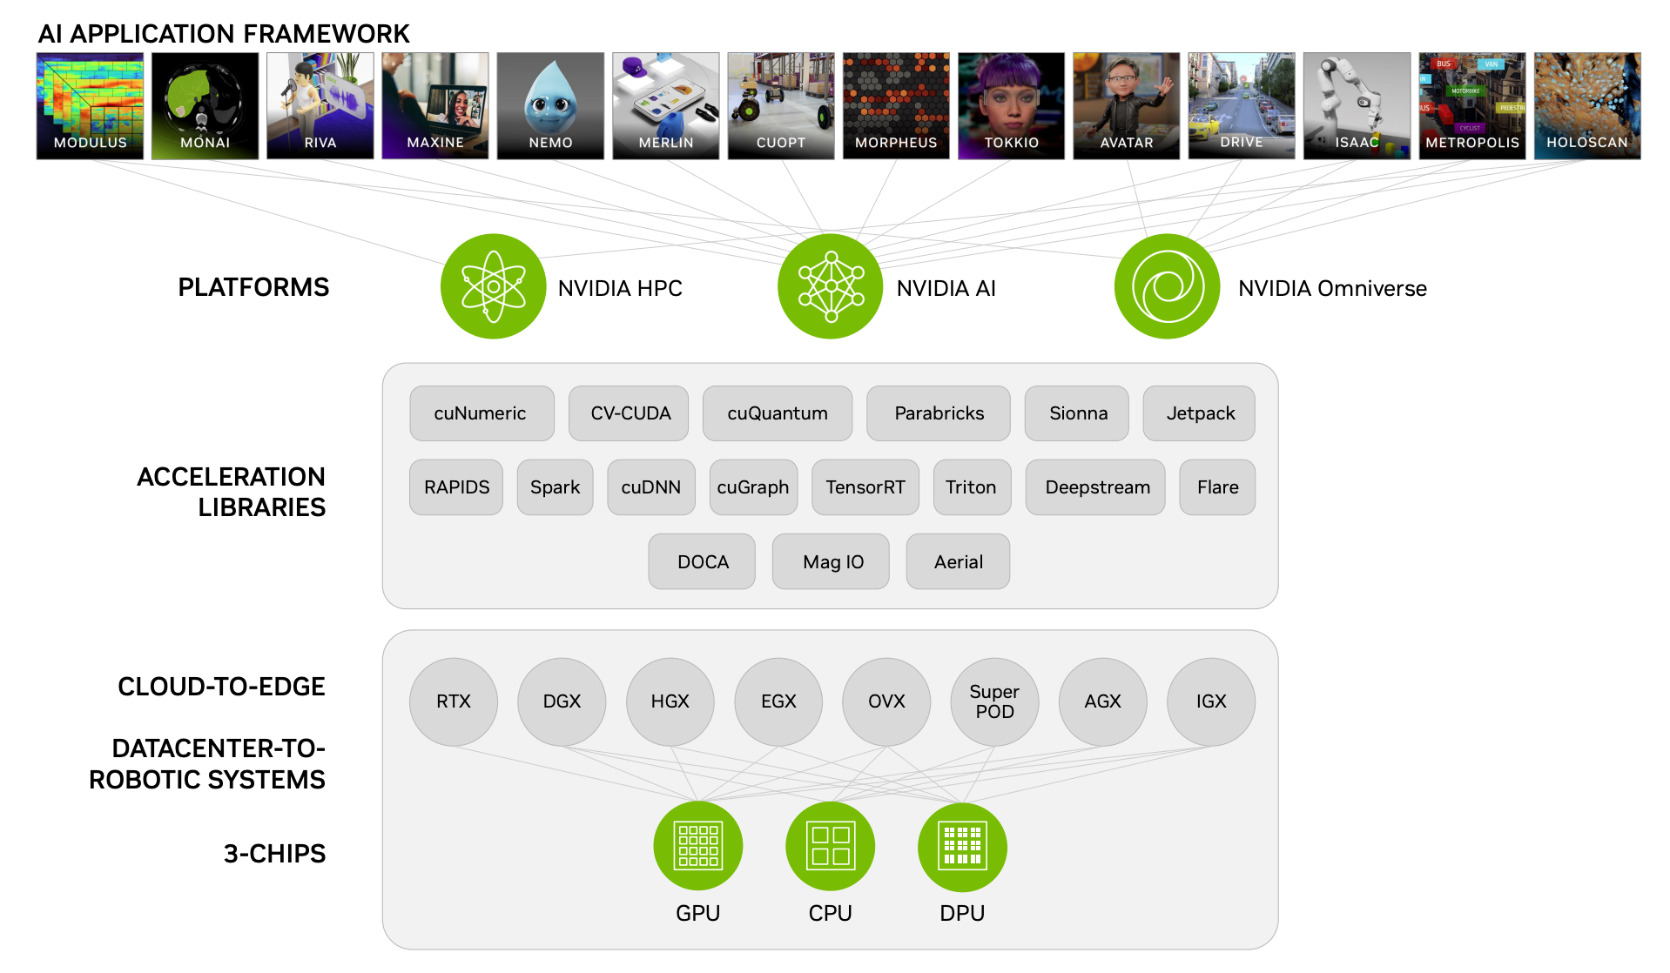
High switching cost as
Nvidia provides full AI support
Notes:
Thus, with lowered cost for AI workloads and growing developer ecosystem. Nvidia is able to provide the full stack of AI support that would incur a high switching cost.

Slide 19








Captures all major cloud service Providers
Notes:
Thus, Nvidia is able to capture all major cloud service providers and Nvidia has a CAGR of 38.6%.

Slide 20
High Future Revenue Growth
AI
Cloud Service Provider
AI applications
Automotive
Datacentres
Notes:
Thank you James. Now, I will elaborate on the ventures we believe NVIDIA will be able to benefit from, leading to better performances.

Slide 21
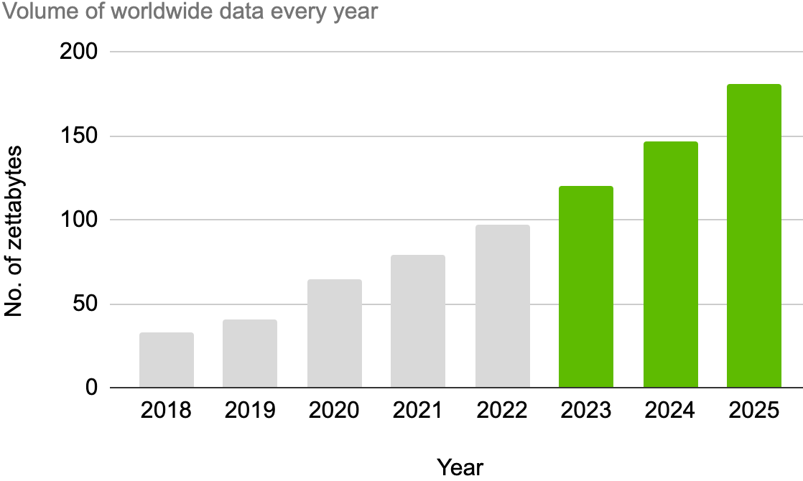
Increasing demand for cloud services
1.8X
Notes:
As more and more businesses are shifting toward the cloud, the need for data centres is increasing.

Slide 22
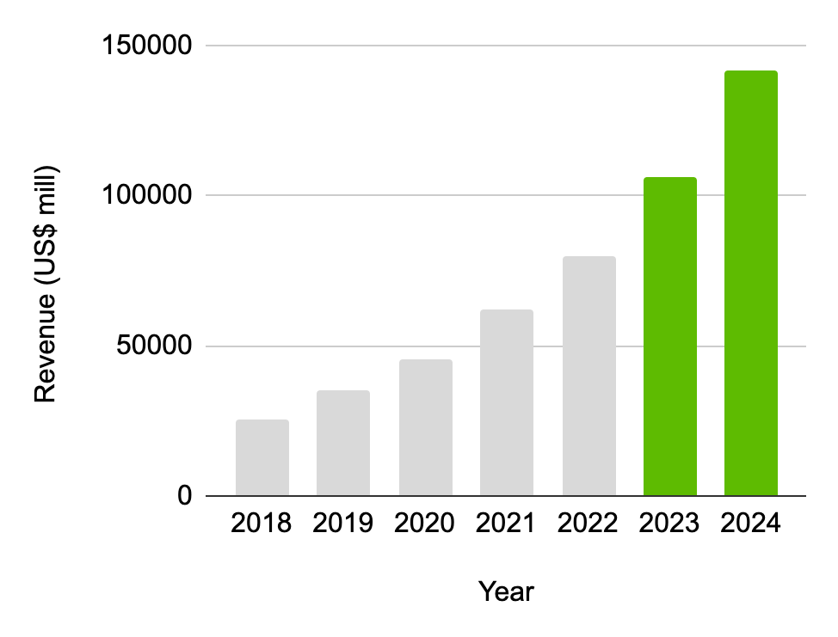
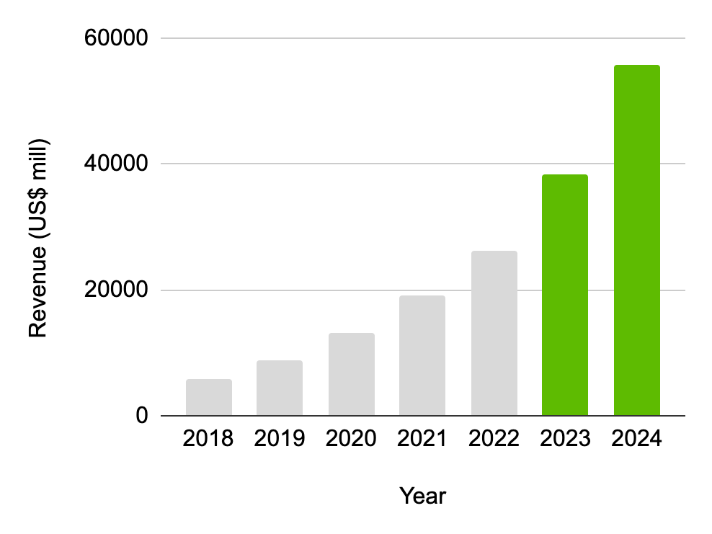
Expected greater shift towards Cloud
1.3X
1.5X
Notes:
To cater to this huge demand, datacenter operators are expanding their operations across the world to cater to increasing worldwide data. The increases in revenue by AWS and Google Cloud will increase demand for Nvidia’s datacentre GPUs as these are data center business that conduct heavy AI workloads.
With plans to focus on new growth boosters and acquisitions like Mellanox, we believe Nvidia is able to capitalize on this demand and consolidate its presence in this niche market.

Slide 23
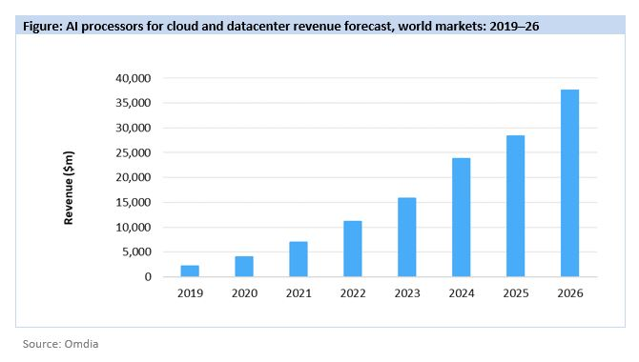
Shift In Demand for Cloud
Nvidia intends to focus on new growth boosters
Inference, data science and machine learning techniques
To consolidate its presence in this niche market
Acquisition of Mellanox
TAM to more than double to $50bn by 2023
Revenue to grow at CAGR of 24.5% through FY2023-2025
Notes:
Furthermore, the company intends to focus on new growth boosters, such as inference, data science and machine learning techniques to consolidate its presence in this niche market. The company’s acquisition of Mellanox is also a key catalyst in this regard.
Nvidia anticipates data center Total Addressable Market (TAM) to more than double to $50 billion by 2023, while estimates from ZACK’s analysis reports suggest that the company’s revenues from the Data Center end-market will grow at a CAGR of 24.5% through fiscal year 2023-2025.

Slide 24
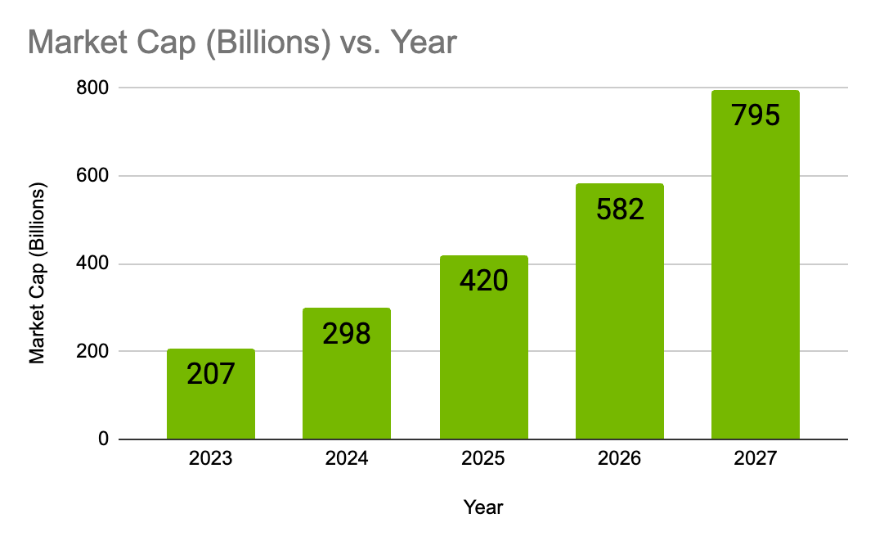
Artificial Intelligence (AI)
Rapid adoption of AI across all industries
Rapidly growing sector for Nvidia's data centre products
(Statista, 2023)
Notes:
The adoption of AI across all industries is also a rapidly growing sector for Nvidia's products, particularly their GPUs.
https://www.statista.com/statistics/1365145/artificial-intelligence-market-size/#:~:text=The%20market%20for%20artificial%20intelligence,a%20vast%20amount%20of%20industries.

Slide 25




Artificial Intelligence (AI)
AI customers include businesses and organizations that use deep learning and other AI techniques for applications such as natural language processing, computer vision, and speech recognition.
GPUs used in medical imaging and drug discovery applications in healthcare
As the adoption of AI in healthcare increases, Nvidia's data centre products could become essential for medical professionals who require powerful GPUs for medical imaging, drug discovery, and other healthcare applications
Deep Learning
Medical Imaging
Computer Vision
Drug Discovery
Notes:
AI customers include businesses and organizations that use deep learning and other AI techniques for applications such as natural language processing and computer vision. NVIDIA is also expanding base in the other untapped markets like healthcare, where their GPUs used in medical imaging and drug discovery applications.
Nvidia's expertise could give them an edge as the demand for AI and machine learning technologies continue to grow in different sectors, placing Nvidia at a good position to achieve high revenue growth in the future.

Slide 26
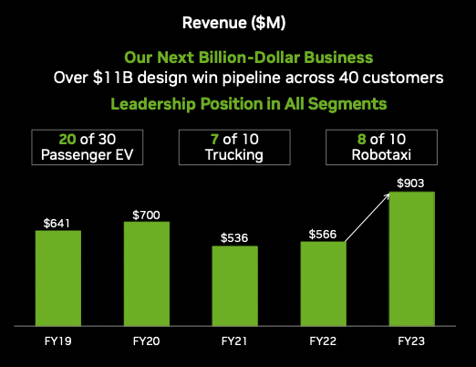
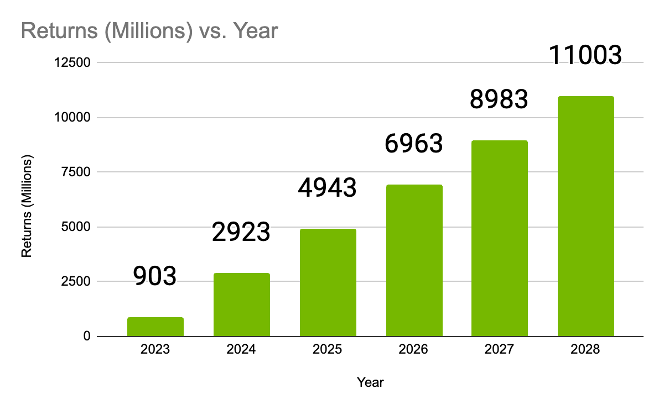
Automotive Industry
Collaboration more than 320 partners
To develop AI systems for self-driving vehicles
Audi, BMW, and Mercedes-Benz
To strengthen presence in the market
Secured 6-year pipeline worth $11bn
Revenue expected to grow at a CAGR of 50% from fiscal 2023-2025
Nvidia’s Next Billion-Dollar Business
$11B
12X
$903M
2023
2028
Notes:
NVIDIA’s foray into the autonomous vehicles and electronics space is also a positive. Collaboration with the likes of Mercedes-Benz, Audi and more than 320 partners to develop and deploy AI systems for self-driving vehicles will strengthen NVIDIA’s presence in this space. In March 2022, NVDA announced that the Automotive business had secured a 6-year pipeline worth US$11bn and analysis reports expect this segment’s revenue to grow at a CAGR of 50% through fiscal year 2023-2025.
Thus, we believe that NVIDIA’s investment into these markets present a solid growth opportunity that will bring about strong growth in revenue and stock prices.
I will now pass the time to Kah Yan to explain the assumptions that must hold in this case.
Additional notes: (NOT TO READ)
Partners = automakers, tier-one suppliers, automotive research institutions, HD mapping companies and start-ups
Notably, NVIDIA’s focus on incorporating AI into the cockpit for infotainment systems is allowing it to grow its autonomous driving revenues.
$30 billion which comprises $25 billion for driving, $3 billion for training/development of deep neural networks and $2 billion for validation and testing
Investor presentation report
https://s201.q4cdn.com/141608511/files/doc_presentations/2023/02/nvda-f4q23-investor-presentation-final.pdf

Slide 27
04
Our
Assumptions
Notes:
Thank you Xin Yi. With all that’s been said, there are indeed some assumptions that have to hold for our reasonings to be true.

Slide 28
Competitors unable to catch up
Increasing competition from a plethora of players
Increasingly easier to design and manufacture new chips
Established chip companies (AMD, Intel)
Hyperscalers (Google, Amazon)
Startups (Cerebras, Graphcore)
Longer-term threat to NVIDIA’s market share
AMD
Significant experience in consumer GPU market
Data centre GPUs quickly catching up in performance
Efforts in building a more comprehensive software portfolio
Acquisitions eg. Xilinx and Pensando
Notes:
Firstly, we have to acknowledge that NVIDIA is facing increasing competition from a plethora of players. With the growing outsourcing of the semiconductor supply chain, it has become increasingly easier to design and manufacture new chips. This includes competition from established chip companies (AMD, Intel), hyperscalers (Google, Amazon who have been pushing their own in-house designed chips), and startups that do pose a longer-term threat to Nvidia’s market share.
Especially for AMD, the more serious competitor to Nvidia. Its Instinct line of data center GPUs is quickly catching up to Nvidia’s performance and while NVIDIA still beats them in terms of software capabilities, there have been efforts in creating a more comprehensive software portfolio, such as the acquisition of Xilinx and Pensando.
Thus, to support our stance, we assume that NVIDIA’s competitors are unable to make a surprise breakthrough with their continued efforts that might affect NVIDIA’s market share and revenues in the coming year.

Slide 29
Lack of
External events
Robust demand for AI
Post-COVID-19 demand
Pricing shock
Inventory issues
Geopolitical concerns
Demand for AI and HPC workloads in the coming future
Notes:
Secondly, we assume that there will be no drastic events that will greatly affect factors like demand or supply that will in turn, affect NVIDIA’s revenues. Last year, NVIDIA’s stock price dropped on multiple occasions due to a multitude of reasons. For example, demand in the gaming market declined as the surge in demand seen through Covid-19 waned. NVIDIA pricing their new 40-series GPUs far higher than the previous generation also caused major shock and affected demand.
This led to NVIDIA having too much stock and slashing prices to clear them. Also, regulations implemented by the US government in October last year impacted exports to China which affected the company's revenue growth since business in China contributes about one-quarter of its revenue.
Therefore, while NVIDIA has since made adjustments and is recovering from such turbulence, we assume that either no such events will happen again or that NVIDIA is at least more prepared to handle them and their stock price will not drop significantly.
Lastly, our belief in how NVIDIA will continue to earn high revenues in its data centre market does rely on the assumption that the demand for AI and HPC workloads will continue to be robust in the future.
However, as NVIDIA’s CEO Jensen Huang mentioned, AI is at an inflection point, setting up for broad adoption reaching into every industry. An example would be the success of ChatGPT, which has triggered an AI race. Thus, we believe it is more likely that the assumption will hold true.

Slide 30
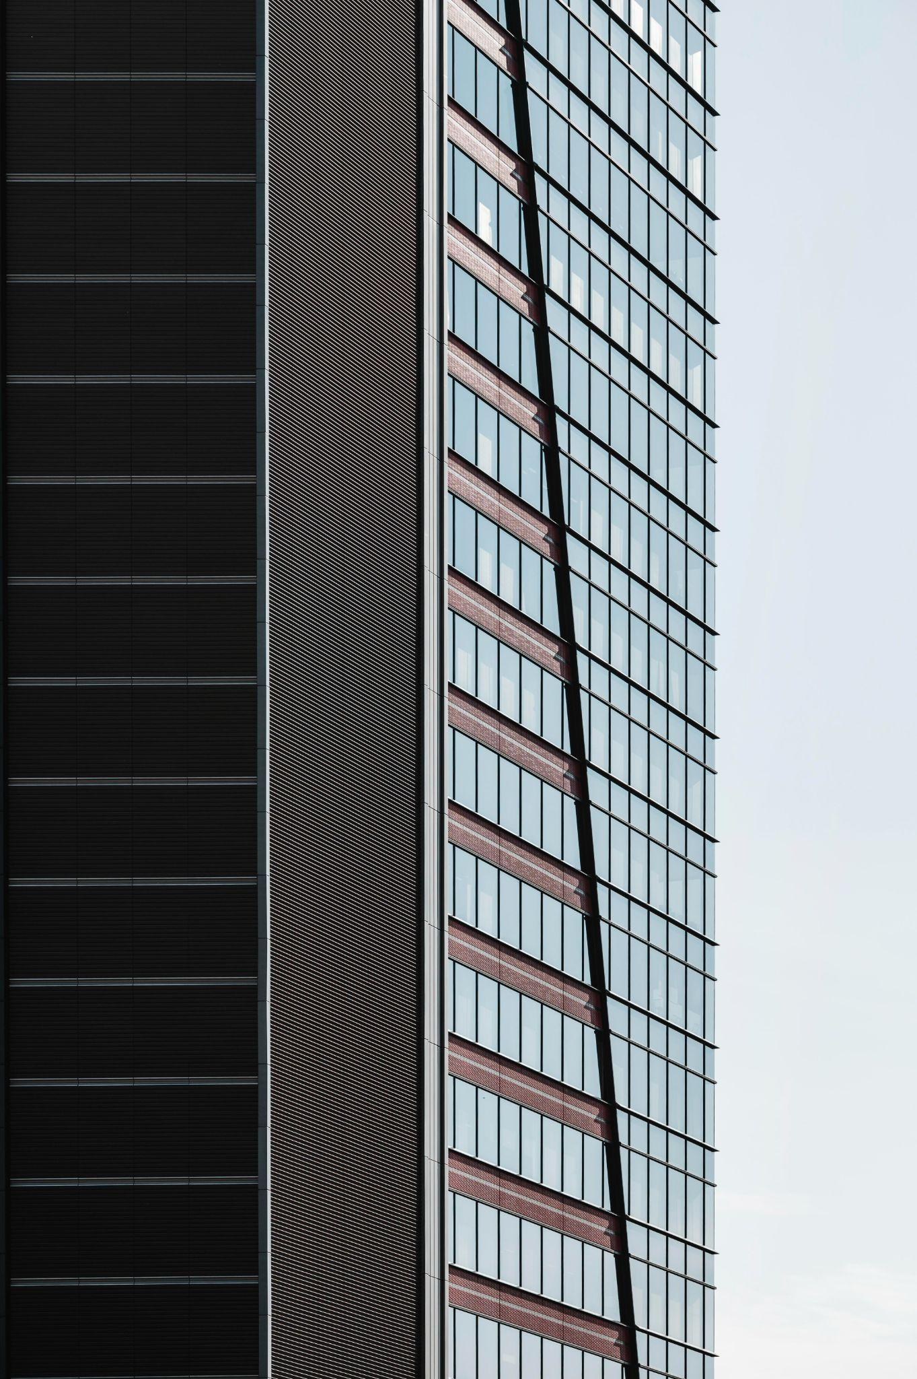
NVIDIA
Powerhouse in industry
Extensive software infrastructure
Preferred partner for industry leaders
Current ventures with high potential for growth
Buy call at USD298.50
Notes:
To conclude, NVIDIA remains a powerhouse in the industry due to its extensive software infrastructure that gives it a competitive edge and makes them the preferred partner for other industry leaders and coupled with its current ventures that have high potential for growth, we reiterate a buy call at USD298.50. Thank you!

Slide 31
THANK YOU!
Notes:
To conclude, NVIDIA remains a powerhouse in the industry due to its extensive software infrastructure that gives it a competitive edge and makes them the preferred partner for other industry leaders and coupled with its current ventures that have high potential for growth, we reiterate a buy call at USD298.50. Thank you!

Slide 32
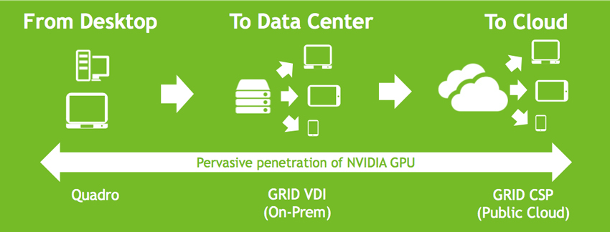
Cloud Service Provider (CSP)
Cloud service providers are the largest customer segment for Nvidia's data centre products.
Notes:
Nvidia is a leading provider of data centre products to cloud service providers (CSPs). CSPs are Nvidia's largest customer segment and use its GPUs for various applications such as machine learning, video transcoding, and scientific simulations. Let’s explore how Nvidia's presence as a cloud service provider will help the company achieve high future revenue growth.

Slide 33
Market Outlook
Nvidia intends to focus on new growth boosters for its data centres business, such as inference, data science and machine learning techniques to consolidate its presence in this niche market.
NVIDIA anticipates data centre TAM to more than double to $50 billion by 2023.
Considered most preferred by data centre operators, NVIDIA’s GPUs are likely to help the company grab a larger market space.
Notes:
Further, the company intends to focus on new growth boosters for its data centres business, such as inference, data science and machine learning techniques to consolidate its presence in this niche market.
Nvidia anticipates data center Total Addressable Market (TAM) to more than double to $50 billion by 2023, and it intends to focus on new growth boosters for its data centers business. Considered most preferred by data centre operators, NVIDIA’s GPUs are likely to help the company grab a larger market space and achieve high revenue growth.
The company’s acquisition of Mellanox is a key catalyst in this regard. Our estimates (ZACKS Analysis reports) suggest that the company’s revenues from the Data Center end- market will grow at a CAGR of 24.5% through fiscal 2023-2025.

Slide 34
Automotive Industry Focus
20 of 30 Passenger EV
7 of 10
Trucking
8 of 10
Robotaxi
Notes:
I dont think we have time for this (if have time)
Investor presentation report
https://s201.q4cdn.com/141608511/files/doc_presentations/2023/02/nvda-f4q23-investor-presentation-final.pdf

Slide 35
NVIDIA's Focus on AI and Infrastructure
NVIDIA has a strong focus on artificial intelligence (AI) and machine learning (ML)
Leveraging its GPU technology to develop solutions for customers to process vast amounts of data quickly and accurately
Leader in the AI market and capitalizing on the growing demand for AI technologies
Developed a suite of software and hardware products for customers to build and deploy AI applications quickly and easily
E.g. NVIDIA EGX is an AI infrastructure platform enabling customers to run AI workloads at the edge of the network, closer to where data is generated
Reduced latency and improved performance, particularly in autonomous vehicles and industrial automation applications
Notes:
NVIDIA's focus strategy and AI infrastructure
NVIDIA has been focusing on artificial intelligence (AI) and machine learning (ML) in recent years, leveraging its GPU technology to develop solutions that enable customers to process vast amounts of data quickly and accurately. This focus has enabled the company to become a leader in the AI market and capitalize on the growing demand for AI technologies.
E.g. NVIDIA has developed a suite of software and hardware products that enable customers to build and deploy AI applications quickly and easily. Its AI infrastructure platform, NVIDIA EGX, enables customers to run AI workloads at the edge of the network, closer to where data is generated. This helps to reduce latency and improve performance, which is important for applications such as autonomous vehicles and industrial automation.
Partners w the top

Slide 36
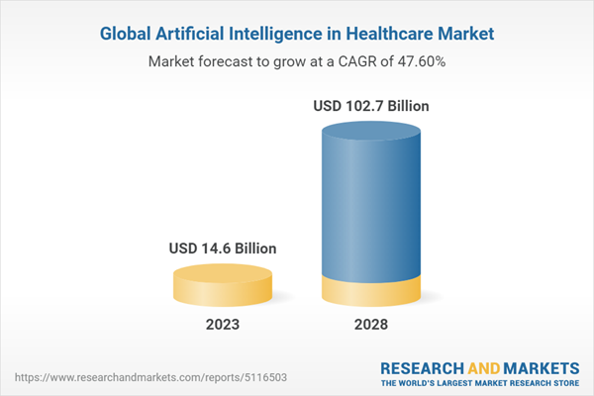
$100 Billion
Global healthcare AI market projected to grow at a CAGR of 40.4% between 2021 and 2028
Notes:
Healthcare is approximated to $10 trillion industry. We can see that there will be an exponential growth for the healthcare AI market, so why is this so significant and how can Nvidia generate as much profits as possible.

Slide 37
Healthcare Industry Focus
GPUs used in medical imaging and drug discovery applications in healthcare
Clara platform enables healthcare providers to process and analyze medical data more efficiently
Clara leverages Nvidia's expertise in AI and deep learning to help healthcare professionals make more accurate and faster diagnoses, develop new treatments and drugs, and improve overall patient outcomes.
GPUs used in medical imaging and drug discovery applications in healthcare
As the adoption of AI in healthcare increases, Nvidia's data centre products could become essential for medical professionals who require powerful GPUs for medical imaging, drug discovery, and other healthcare applications
Notes:
In addition to its focus on AI, NVIDIA has been expanding its presence in the healthcare and automotive industries. In healthcare, NVIDIA's GPUs are used in medical imaging and drug discovery applications. The company has also developed an AI-powered platform called Clara that enables healthcare providers to process and analyze medical data more efficiently.
Nvidia's expertise in AI and data science techniques could give them an edge as the demand for AI and machine learning technologies continues to grow in the healthcare sector, and help them capture a larger market share.

Slide 38
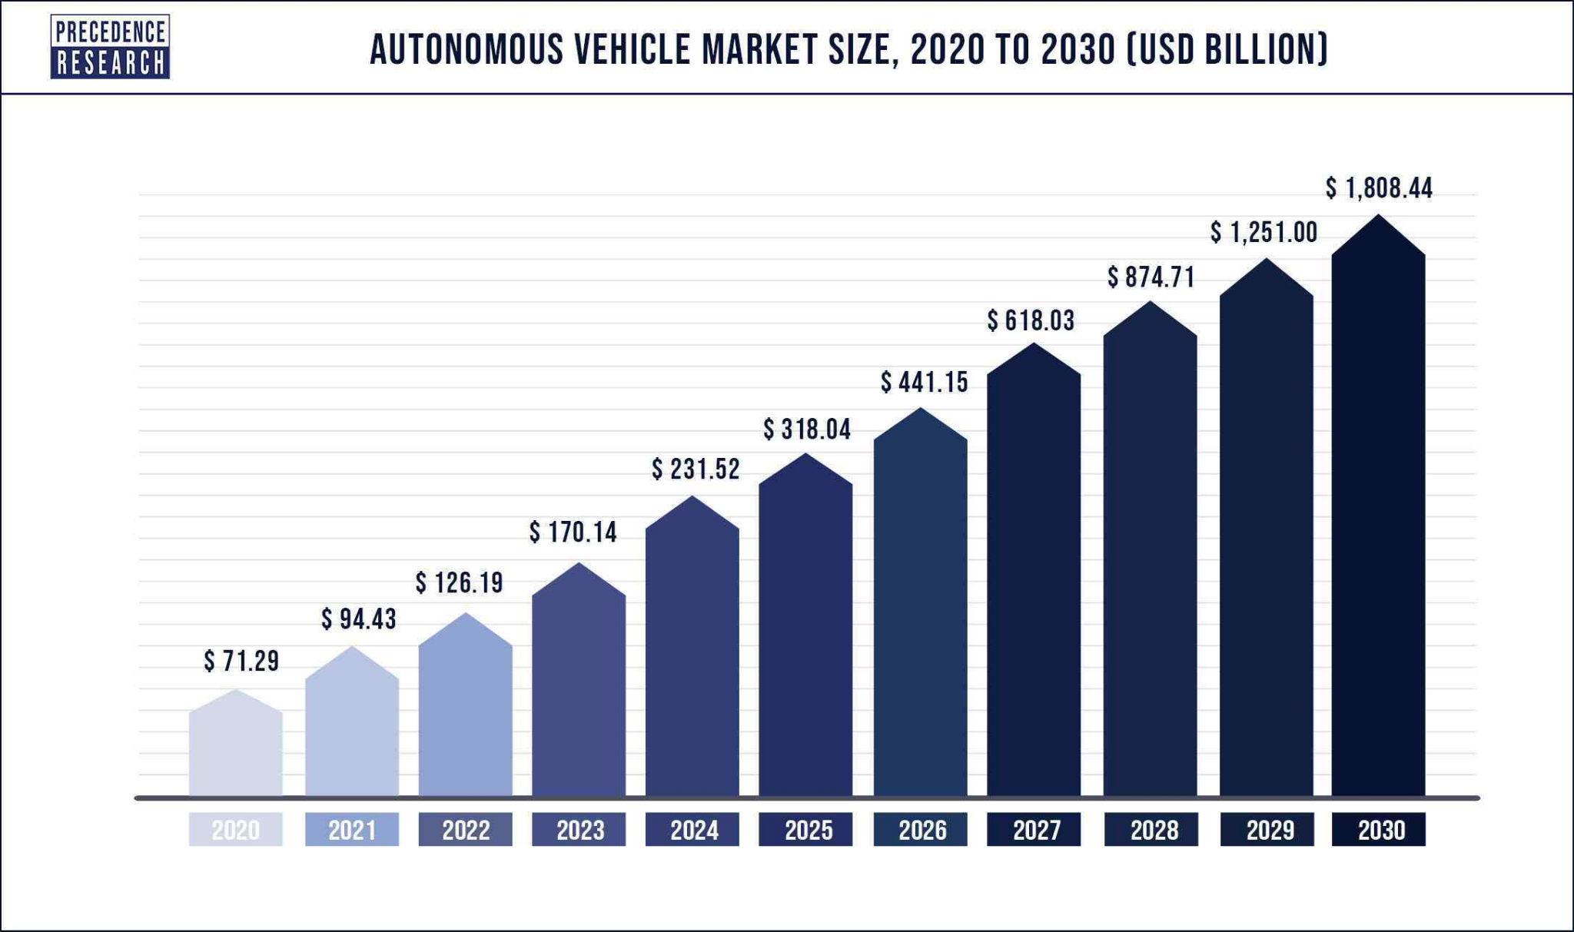
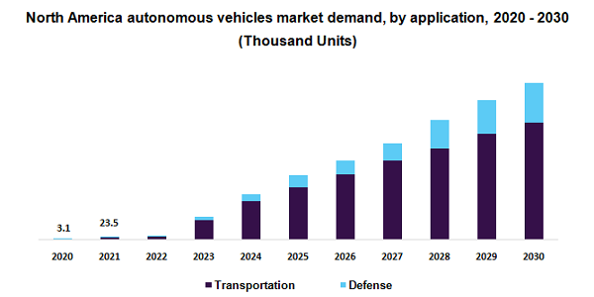
Global autonomous vehicle market projected to grow at a CAGR of 63.1% between 2020 and 2030
Notes:
The healthcare and automotive industries are both expected to see significant growth in the coming years, which could provide opportunities for NVIDIA. The global healthcare AI market is projected to grow at a compound annual growth rate (CAGR) of 40.4% between 2021 and 2028, according to a report by Grand View Research. Meanwhile, the global autonomous vehicle market is projected to grow at a CAGR of 63.1% between 2020 and 2030, according to a report by MarketsandMarkets.
E.g. In the automotive industry, NVIDIA's GPUs are used in autonomous vehicle applications, enabling vehicles to process and analyze large amounts of sensor data in real time. The company has partnerships with several leading automakers, including Audi, BMW, and Mercedes-Benz, and has developed a platform called DRIVE that enables the development and deployment of autonomous vehicle technology.
NVIDIA's strong position in the automotive industry and partnerships with leading automakers position it for growth in the autonomous vehicle market
NVIDIA's focus on these industries, combined with projected growth, makes it an attractive investment opportunity with potential for strong returns.

Slide 39
Competitors
AMD and Intel
NVIDIA's acquisition of Mellanox Technologies in 2020 aimed to enhance the company's capabilities in high-performance computing and networking solutions. Here are some key benefits:
Strengthening data center capabilities: Mellanox's technology enables faster data transfer and processing, enhancing the performance and efficiency of NVIDIA's data center products.
Expanding customer base: NVIDIA gains access to Mellanox's strong customer base in the data center market, enabling it to sell its own products and services and expand its revenue.
Diversifying revenue streams: NVIDIA can reduce its reliance on its GPU business and generate revenue from other sources by expanding into the data center market.

Slide 40
Competitors
NVIDIA's Platform Strategy
Platform strategy combines hardware and systems, software, algorithms and libraries, and services to create unique value for end markets
Unified underlying architecture leveraging GPUs and software stacks to address diverse computing requirements of end markets
Programmable nature of architecture allows support for several multi-billion-dollar end markets with the same underlying technology
Large and growing number of developers across platforms strengthens ecosystem and increases value of platform to customers

Slide 41
Competitors
NVIDIA's Success and Competition
NVIDIA is a dominant name in the Data Center, professional visualization and gaming markets where Intel and AMD are playing a catch-up role.
NVIDIA's GPU platforms are playing a major role in developing multi-billion-dollar end-markets like robotics and self-driving vehicles.
NVIDIA's partnership with almost all major cloud service providers (CSPs) and server vendors is a key catalyst.
Notes:
GPU success attributed to parallel processing capabilities supported by thousands of computing cores necessary to run deep learning algorithms
Dominant name in Data Center, professional visualization, and gaming markets, where Intel and AMD are playing a catch-up role
Limited scope for growth in apps processor market dominated by Apple, Samsung, and Qualcomm
Competitive pressure from Intel and AMD planning to integrate graphics cores into their chips may negatively impact NVIDIA's revenues in the long haul
AMD's acquisition of Xilinx has posed a new competitive challenge for NVIDIA in fast-growing data-center chip market

Slide 42
Competitors
Competition
AMD is making an effort to strengthen its position in the commodity graphics segment and CPUs for console gaming systems.
AMD's acquisition of Xilinx has posed a new competitive challenge for NVIDIA in its fast-growing data-center chip market.
Competitive pressure from two CPU vendors, Intel and AMD, who are planning to integrate graphics cores into their chips can negatively impact NVIDIA’s revenues in the long haul.

Slide 43
Competitors
NVIDIA's Software
NVIDIA makes their products very sticky by creating software infrastructure that makes it hard for customers to shift, particularly in the data center.
NVIDIA benefits by selling full-on supercomputers for AI applications, which can go for hundreds of thousands of dollars.
Unlike AMD, NVIDIA doesn’t sell both CPUs and GPUs, and unlike Intel, it isn’t reentering the discrete GPU market. The company is set to launch its own CPU code named Grace to ensure it can provide its customers with its own CPU.

Slide 44
Competitors
AMD's Software
AMD's upcoming MI300 has a shot at competing with NVIDIA's Grace/Hopper Superchip, but unknowns will determine how well it performs for AI applications
AMD has yet to catch up with NVIDIA's software stack for AI applications.
AMD's ROCm libraries are roughly equivalent to ONE of the little icons on NVIDIA's software stack.
AMD has no Triton Inference server, no RAPIDS, no TensorRT, etc., etc., etc. And there is no hint of anything approaching the 14 application frameworks on the top of NVIDIA’s stack.

Slide 45
Competitors
Conclusion and Future Outlook
In conclusion, both NVIDIA and AMD are major players in the semiconductor industry with a focus on high-performance computing and graphics technologies. While NVIDIA has a strong position in the data center, gaming, and AI markets, AMD is looking to strengthen its position in the commodity graphics segment and CPUs for console gaming systems. The recent acquisition of Xilinx by AMD has also posed a new competitive challenge for NVIDIA in the fast-growing data-center chip market.
Looking ahead, software will continue to be a crucial factor in determining the success of both companies in the AI and HPC markets. NVIDIA has a strong advantage with its software stack, but AMD is making progress with its ROCm libraries. Additionally, both companies will face competition from other major players such as Intel and Qualcomm, who are also looking to expand their presence in the AI and HPC markets.
Overall, the future looks bright for both NVIDIA and AMD as the demand for high-performance computing and graphics technologies continues to grow. With their strong focus on innovation and partnerships with major players in the industry, both companies are well-positioned to capture new opportunities and drive further growth in the years to come.

Slide 46
Data Centres
NVIDIA's Acquisition of Mellanox Technologies
NVIDIA's acquisition of Mellanox Technologies in 2020 aimed to enhance the company's capabilities in high-performance computing and networking solutions. Here are some key benefits:
Strengthening data center capabilities: Mellanox's technology enables faster data transfer and processing, enhancing the performance and efficiency of NVIDIA's data center products.
Expanding customer base: NVIDIA gains access to Mellanox's strong customer base in the data center market, enabling it to sell its own products and services and expand its revenue.
Diversifying revenue streams: NVIDIA can reduce its reliance on its GPU business and generate revenue from other sources by expanding into the data center market.

Slide 47
Data Centres
Benefits of Mellanox Acquisition - Data Center
Mellanox's technology enables faster data transfer and processing in data center applications such as AI, machine learning, and high-performance computing.
NVIDIA can improve the performance and efficiency of its data center products by integrating Mellanox's technology.
This strengthens NVIDIA's capabilities in the data center market and better meets the needs of its customers.

